Slide 1
HANDS ON: Introduction to RNA-Seq Differential Expression Analysis
Bioinformàtica per a la Recerca Biomèdica
Esther Camacho¹, Angel Blanco^{1,2}, Mireia Ferrer¹, Álex Sánchez^{1,2}
1 Unitat d’Estadística i Bioinformàtica (UEB) VHIR
2 Departament de Genètica, Microbiologia i Estadística, UB

Slide 2
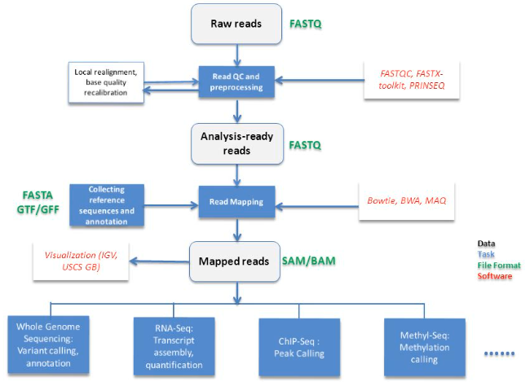
Steps in NGS data analysis
We will have different data formats and tools for each step

Slide 3
Steps in NGS data analysis
We will have different data formats and tools for each step

Slide 4
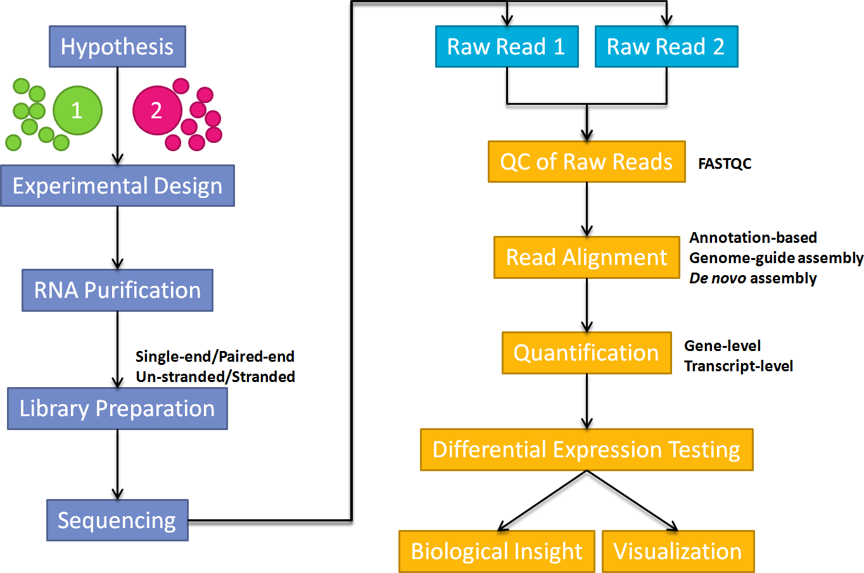
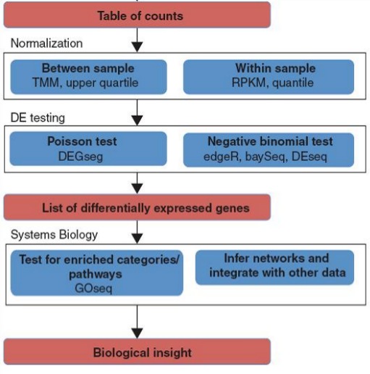
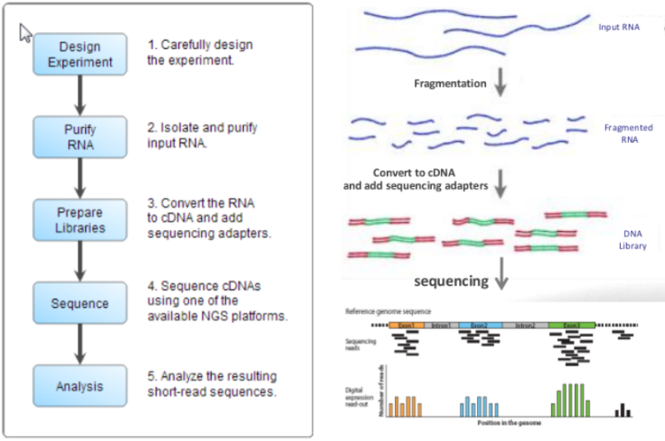
RNA-seq Expression Analysis Workflow
Differential expression analysis
Wednesday

Slide 5
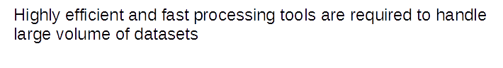
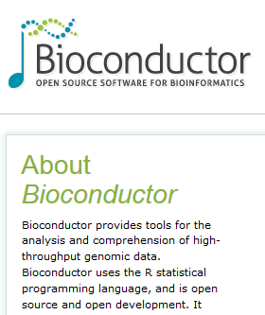
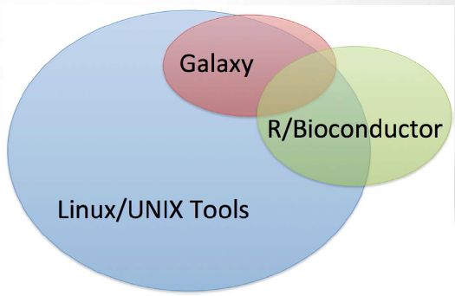
Tools for NGS data analysis
https://www.bioconductor.org/

Slide 6
Today’s practicum
Steps covered by the tutorial:
Start with the FASTQ files (how they are aligned to the genome)
Summarization/Quantification of aligned reads: obtaining the counts matrix
Data pre-processing and exploratory analysis
Differential gene expression analysis
Visually explore the results
This material has been created using the following sources:
https://combine-australia.github.io/RNAseq-R/
https://bioconductor.org/packages/release/workflows/vignettes/RNAseq123/inst/doc/limmaWorkflow.html

Slide 7
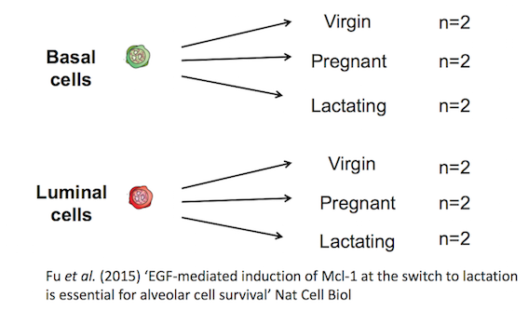
Study overview
Objective: We want to identify genes differentially expressed in the lactating versus pregnant mammary gland
Dataset: RNA-seq data of mouse mammary gland (GSE60450)
Note: two biological replicates are used here, however three replicates is usually recommended as a minimum requirement for RNA-seq.

Slide 8
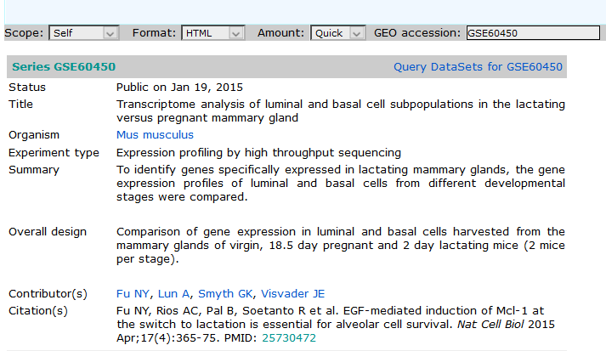
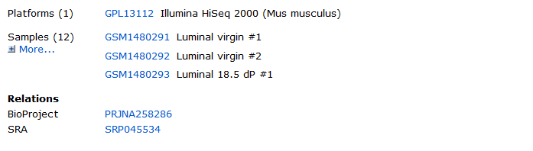
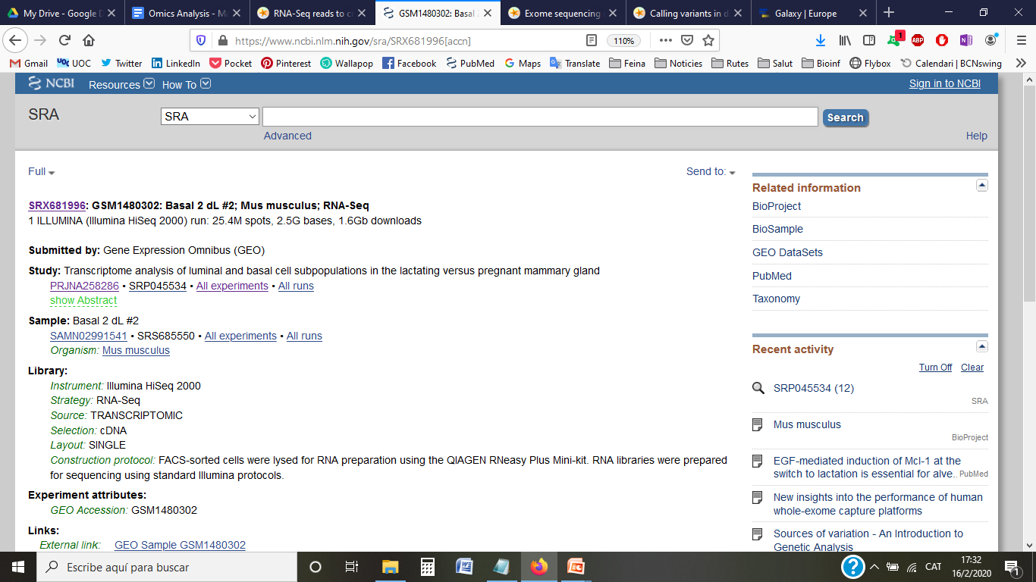
GSE60450
https://www.ncbi.nlm.nih.gov/geo/query/acc.cgi?acc=GSE60450

Slide 9
Getting started
Hands on!
... follow sections 1-2 of the Rmd file

Slide 10
Steps covered in this tutorial:
Summarization/Quantification of aligned reads: obtaining the counts matrix
Data pre-processing and exploratory analysis
Differential gene expression analysis
Visually explore the results

Slide 11
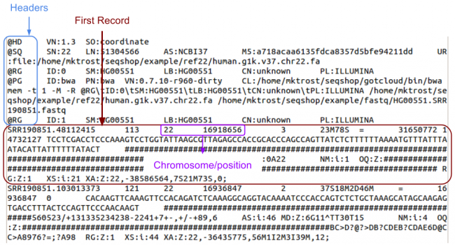
Step 1: Summarization/Quantification of reads: obtaining the counts matrix
The alignment produces a set of BAM files, where each file contains the read alignments for each sample.
In the BAM file, there is a chromosomal location for every read that was mapped.
http://samtools.github.io/hts-specs/SAMv1.pdf
Notes:
11

Slide 12
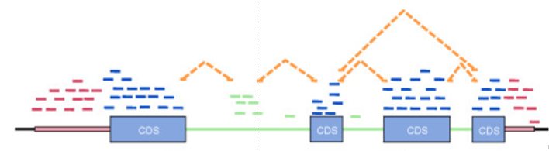
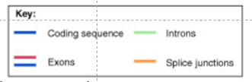
Step 1: Summarization/Quantification of reads: obtaining the counts matrix
We need to summarize and aggregate reads over some biologically meaningful unit, such as exons, transcripts, genes, regions …
Many methods available
Notes:
12

Slide 13
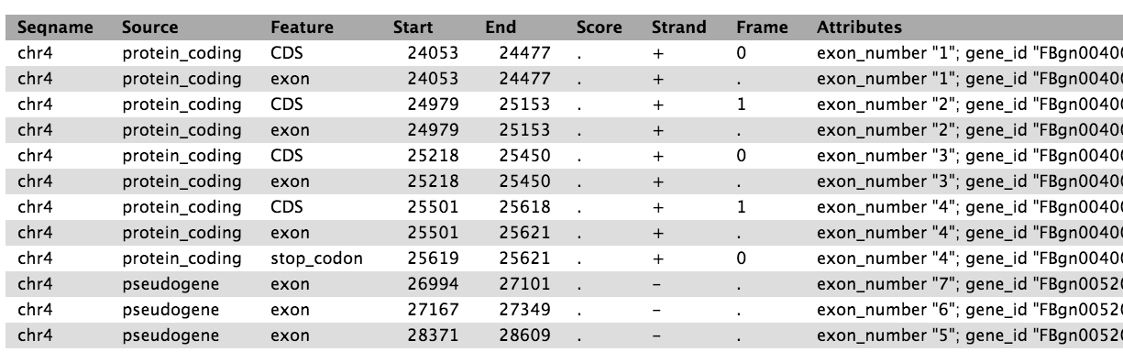
Step 1: Summarization/Quantification of reads: obtaining the counts matrix
Requires gene annotation specifying the genomic start and end position of each exon of each gene . Usually this is contained in a data frame in GTF format for each organism.

Slide 14
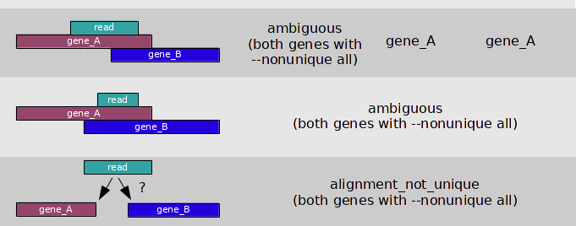
Step 1: Summarization/Quantification of reads: obtaining the counts matrix
Reads that map to exons of genes are added together to obtain the count for each gene
There may be some ambiguities
Notes:
14

Slide 15
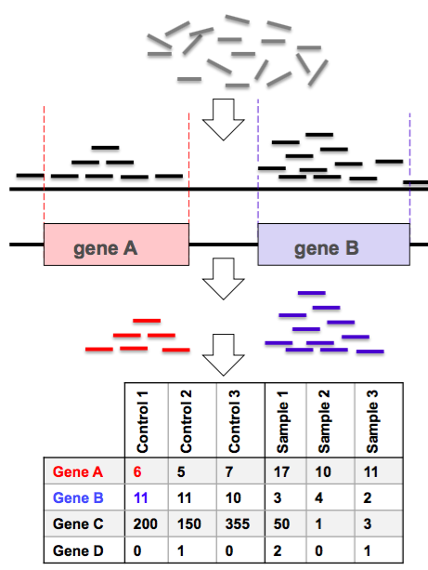
Step 1: Summarization/Quantification of reads: obtaining the counts matrix
The summarized RNA-seq data is widely known as a count matrix

Slide 16
Step 1: Summarization/Quantification of reads: obtaining the counts matrix
Hands on!
... follow sections 3-4 of the Rmd file

Slide 17
Steps covered in this tutorial:
Summarization/Quantification of aligned reads: obtaining the counts matrix
Data pre-processing and exploratory analysis
Differential gene expression analysis
Visually explore the results

Slide 18
Step 2: Data pre-processing and exploratory analysis
How my data looks like?
Is it of enough quality for analysis?
Are there some outlier samples that should be removed?
Are samples grouped according to the experimental conditions?
What are the main sources of variability in the data?
Notes:
18

Slide 19
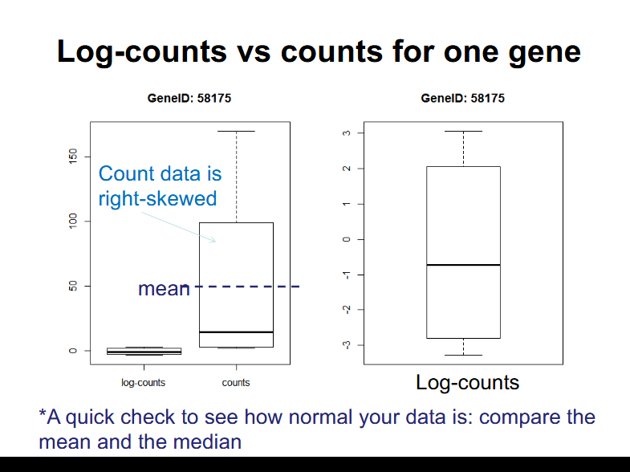
Step 2: Data pre-processing and exploratory analysis
RNA-seq data is
- discrete
- has non-constant mean-variance trend
Non-normal distribution of count data

Slide 20
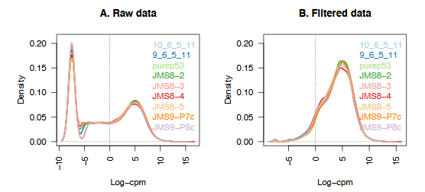
Step 2: Data pre-processing and exploratory analysis
Filtering
It is recommended to filter for lowly expressed genes before differential expression testing.
provide little evidence for differential expression and they interfere with some of the statistical approximations used
Add to the multiple testing burden when estimating FDR, reducing power to detect differential expressed genes.
Notes:
20

Slide 21
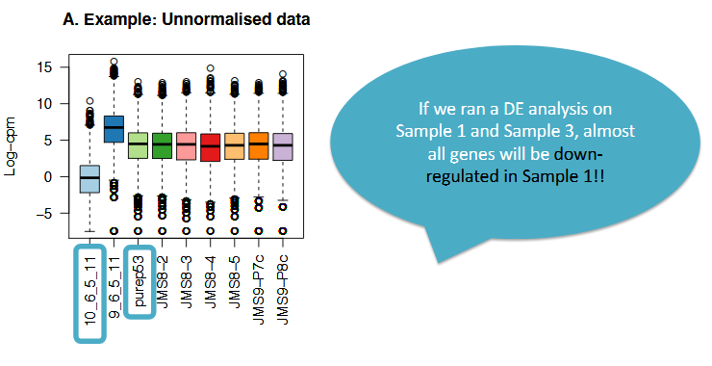
Step 2: Data pre-processing and exploratory analysis
Scaling and normalization
The counts of mapped reads for each gene is proportional to the expression of RNA (“interesting”) in addition to many other factors (“uninteresting”).
Normalization is the process of scaling raw count values to account for the “uninteresting” factors.
https://hbctraining.github.io/DGE_workshop/lessons/02_DGE_count_normalization.html
Notes:
21

Slide 22
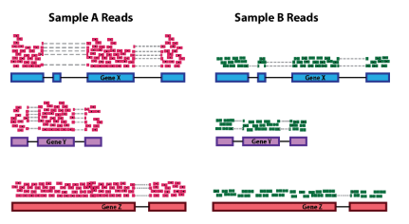
Step 2: Data pre-processing and exploratory analysis
Scaling and normalization
Main factors often considered during normalization are:
Sequencing depth: total number or reads mapped to the genome
https://hbctraining.github.io/DGE_workshop/lessons/02_DGE_count_normalization.html
Notes:
22

Slide 23
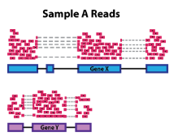
Step 2: Data pre-processing and exploratory analysis
Scaling and normalization
Main factors often considered during normalization are:
Gene length: Accounting for gene length is necessary for comparing expression between different genes within the same sample.
https://hbctraining.github.io/DGE_workshop/lessons/02_DGE_count_normalization.html
Notes:
23

Slide 24
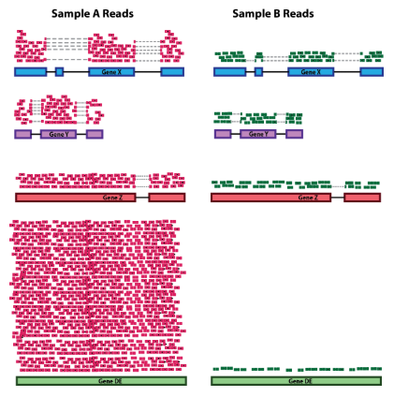
Step 2: Data pre-processing and exploratory analysis
Scaling and normalization
Main factors often considered during normalization are:
RNA composition: A few highly differentially expressed genes between samples, differences in the number of genes expressed between samples, or presence of contamination can skew some types of normalization methods.
https://hbctraining.github.io/DGE_workshop/lessons/02_DGE_count_normalization.html
Notes:
24

Slide 25
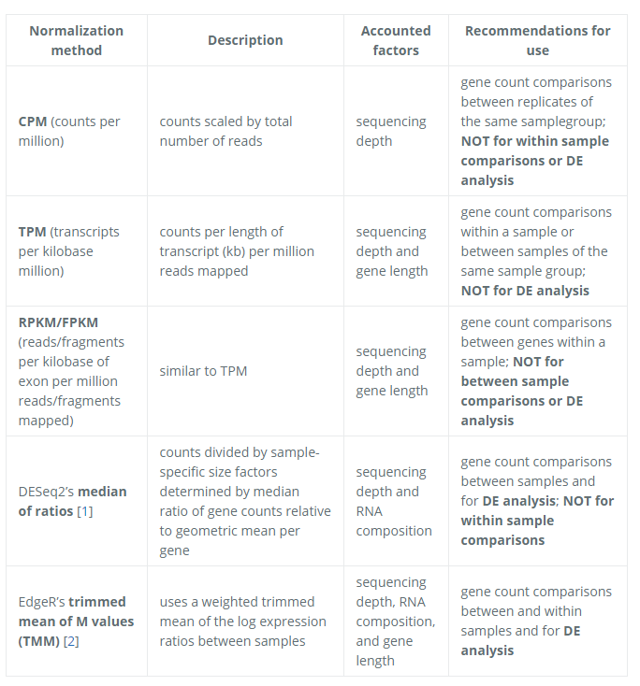
Step 2: Data pre-processing and exploratory analysis
Scaling and normalization
https://hbctraining.github.io/DGE_workshop/lessons/02_DGE_count_normalization.html
Notes:
25

Slide 26
Step 2: Data pre-processing and exploratory analysis
Exploratory analysis
Unsupervised-separation methods based on data, without prior knowledge of experimental design, can be used to get an overview of the data
Do samples separate by experimental groups?
Where the greatest sources of variation in the data come from?
Are there any outliers?

Slide 27
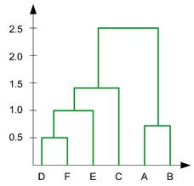
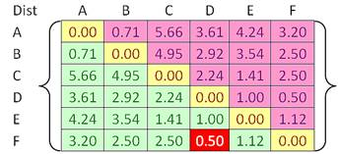
Step 2: Data pre-processing and exploratory analysis
Exploratory analysis
Hierarchical clustering
Hierarchical clustering is typically based on pairwise comparisons of individual samples, which are grouped into “neighborhoods” of similar samples. The basis of hierarchical clustering is therefore a matrix of similarity metrics.

Slide 28
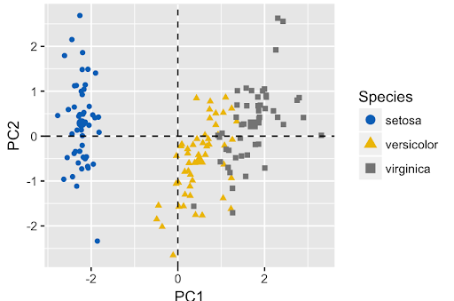
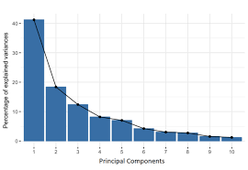
Step 2: Data pre-processing and exploratory analysis
Exploratory analysis
Principal Components Analysis (PCA)
A dimensionality reduction approach that aims to find groups of features (e.g., genes) that have something in common (e.g., certain patterns of expression across different samples)
Few dimensions (components) can be used to represent the information from thousands of mRNAs.

Slide 29
Step 2: Data pre-processing and exploratory analysis
Hands on!
... follow section 5 of the Rmd file

Slide 30
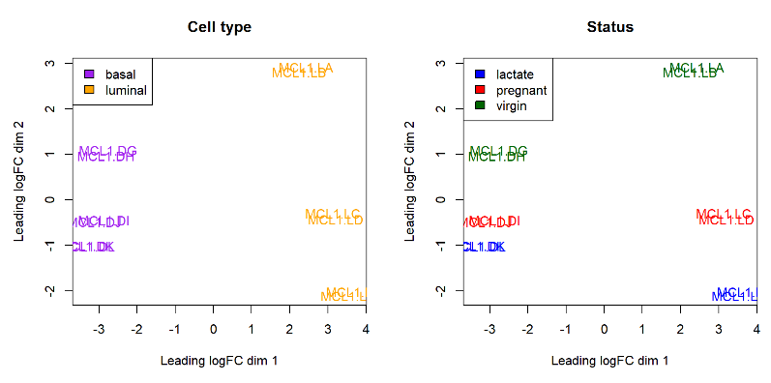
Step 2: Data pre-processing and exploratory analysis

Slide 31
Step 2: Data pre-processing and exploratory analysis

Slide 32
Steps covered in this tutorial:
Summarization/Quantification of aligned reads: obtaining the counts matrix
Data pre-processing and exploratory analysis
Differential gene expression analysis
Visually explore the results

Slide 33
Step 3: Differential expression analysis
2 cell types
3 gestational stages
6 Groups:
Basal.Virgin
Basal.Pregnant
Basal.Lactating
Luminal.Virgin
Luminal.Pregnant
Luminal.Lactating
We will analyze the following comparisons:
Basal.Lactating vs. Basal.Pregnant
Luminal.Lactating vs. Luminal.Pregnant

Slide 34
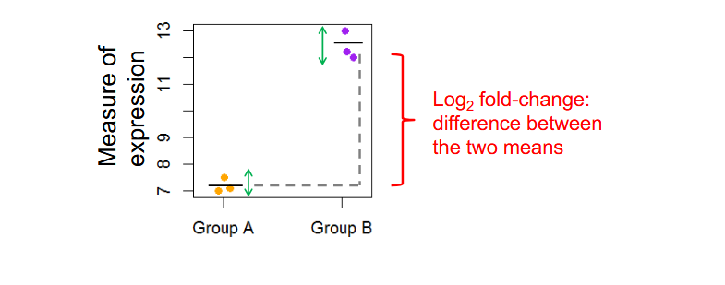
Step 3: Differential expression analysis
What do we need to perform a statistical test?
Measure of average expression
Measure of variability
Finally we will be assigning a p-value for each test/gene.

Slide 35
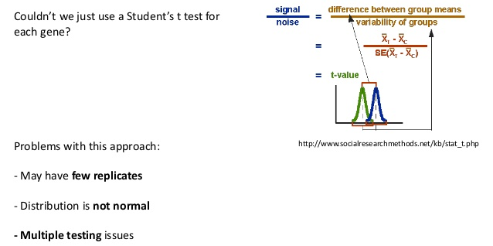
Step 3: Differential expression analysis

Slide 36
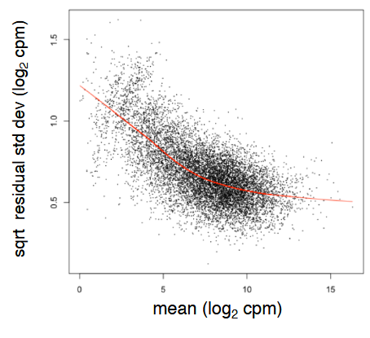
RNA-seq data is
- discrete
- has non-constant mean-variance trend
Mean-variance relationship
Non-normal distribution of count data

Slide 37
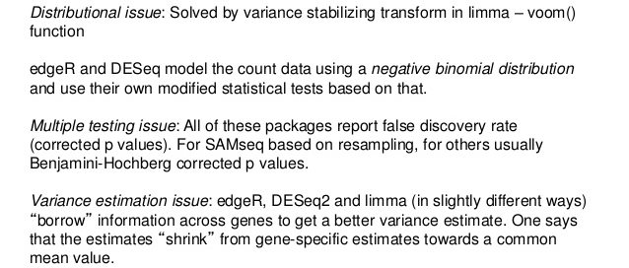
Step 3: Differential expression analysis
Different software use different approaches to deal with the “t test issues”

Slide 38
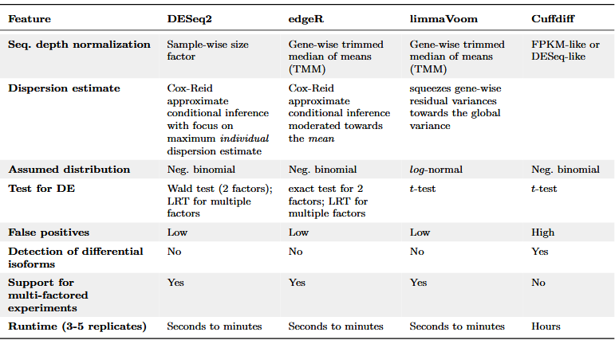
Step 3: Differential expression analysis
https://chagall.med.cornell.edu/RNASEQcourse/Intro2RNAseq.pdf

Slide 39
Step 3: Differential expression analysis
https://chagall.med.cornell.edu/RNASEQcourse/Intro2RNAseq.pdf

Slide 40
Step 3: Differential expression analysis
Hands on!
... follow sections 6.1-6.4 of the Rmd file

Slide 41
Steps covered in this tutorial:
Summarization/Quantification of aligned reads: obtaining the counts matrix
Data pre-processing and exploratory analysis
Differential gene expression analysis
Visually explore the results

Slide 42
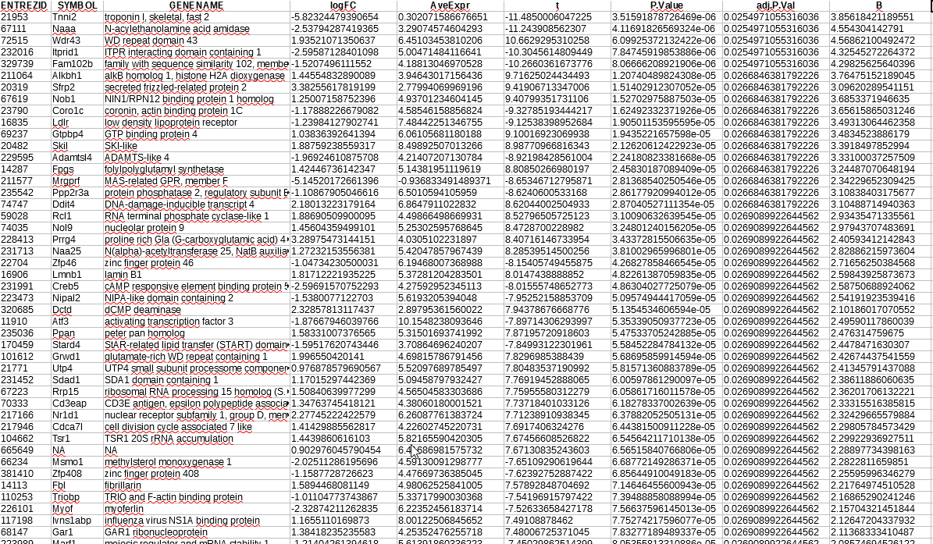
Step 4: Visual exploration of results
For each comparison, the output of a differential expression analysis gives a top table
The logFC column gives the log2-fold change in expression of a gene between the two groups tested
The AveExpr column gives the average log2-expression level for that gene across all the samples
Column t is the moderated t-statistic.
Column P.Value is the associated p-value
adj.P.Value is the p-value adjusted for multiple testing. The most popular form of adjustment is “BH” which is Benjamini and Hochberg’s method to control the false discovery rate.
The B-statistic is the log-odds that the gene is differentially expressed
Notes:
42

Slide 43
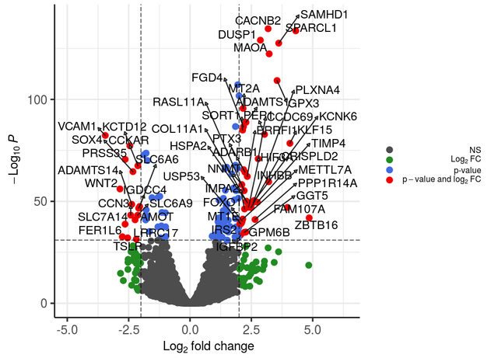
Step 4: Visual exploration of results
A common visualisation is the Volcano Plot which display a measure of significance on the y-axis and fold-change on the x-axis
Notes:
43

Slide 44
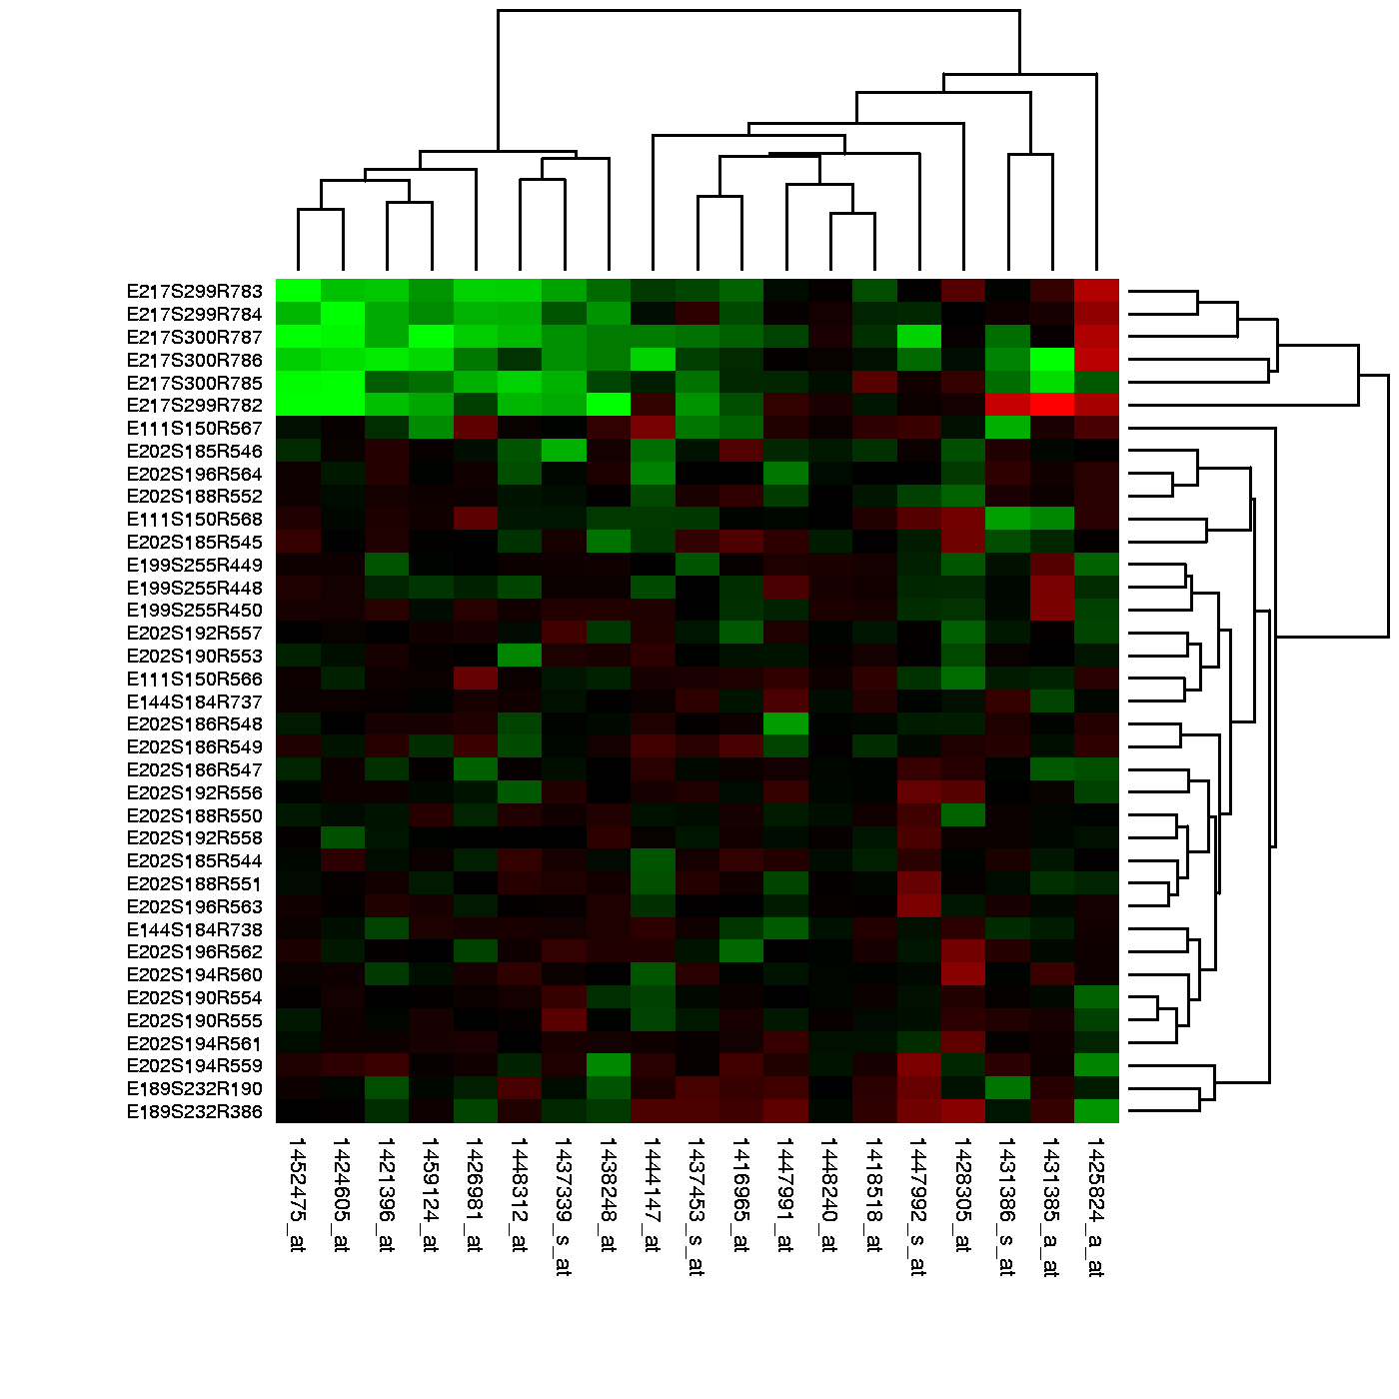
Step 4: Visual exploration of results
Heatmap is a very useful tool for quick representation of quantitative differences in expression levels of biological data.
Each gene is represented as a row and is color-coded to represent the intensity of its variation (either positive or negative) relative to a reference value.
Biological samples are represented as columns in the grid.
Heatmap representations are also combined with clustering methods to group genes and/or samples based on their expression patterns.
Notes:
44

Slide 45
Step 4: Visual exploration of results
Hands on!
... follow section 6.5 of the Rmd file

Slide 46
Next step…
We have performed analysis on gene level
It would be interesting to look for how these genes act together
Analysis of biological significance
Notes:
46

